Slide 1
Bagged.Cluster.ETS
經碩一 鄭仲恒
經碩一 劉仁豪

Slide 2
content
1.Introduction
2.Method
3.Empirical data &Simulation
4.Conclusions

Slide 3
1. Introdution
Bergmeir,Hyndam(2016)
method:BLD.MBB.ETS
good result:montly data(M3)
Problem
Not consider the correlation of bootstrap ,this problem will affect forecast error
Use MSFE as criterion
*MSFE
(consist of a sum fo varince & squard biases)
回顧背景 所有學者用bagged 做預測共同問題 和貢獻
估計的reminder series 有可能產生共變問題
what is cluster how it work
algorithm how generate new series from original dataset
bootsrapped series
box-cox transformation -> loess or STL (seasonal) -> Moving block boostrapped ->inverse box-cox to series
cluster
放回顧東西 共同問題
Bremain (1996)
method: Bagging
Cordeiro & Neves(2009)
method:Boot.EXPOS
good result:
quarterly and monthly data
Author apporach method: Bagged.Cluster.ETS
(consider the problem of correlation)

Slide 4
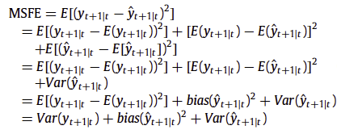
Why bagging tend to work
MSFE
Var( y(t+1|t) ) can’t be control
MIN (Bias_forcating)^2 + (Var_forcating)
Good forecasting methods tend to have low biases and low variances, and consequently,low MSFEs

Slide 5

Why bagging tend to work
Notation
(y_tail_forcating) : Average forecast from bootstrap samples
( y_hat_star) : The forcast for instant t+1 at t, using the i bootsprapped
B is the total number of bootstrap smaples

Slide 6
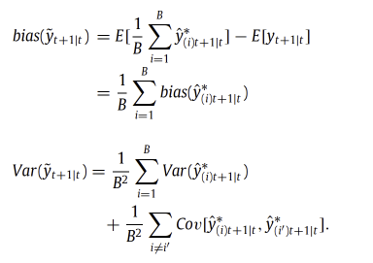
why bagging tend to work
Bagging:
The group of forecasting generated by the resampled
versions are expected to have similar biases but a reduced variance.
The former author, assumption that there is no correlation among bootstrap sample.

Slide 7
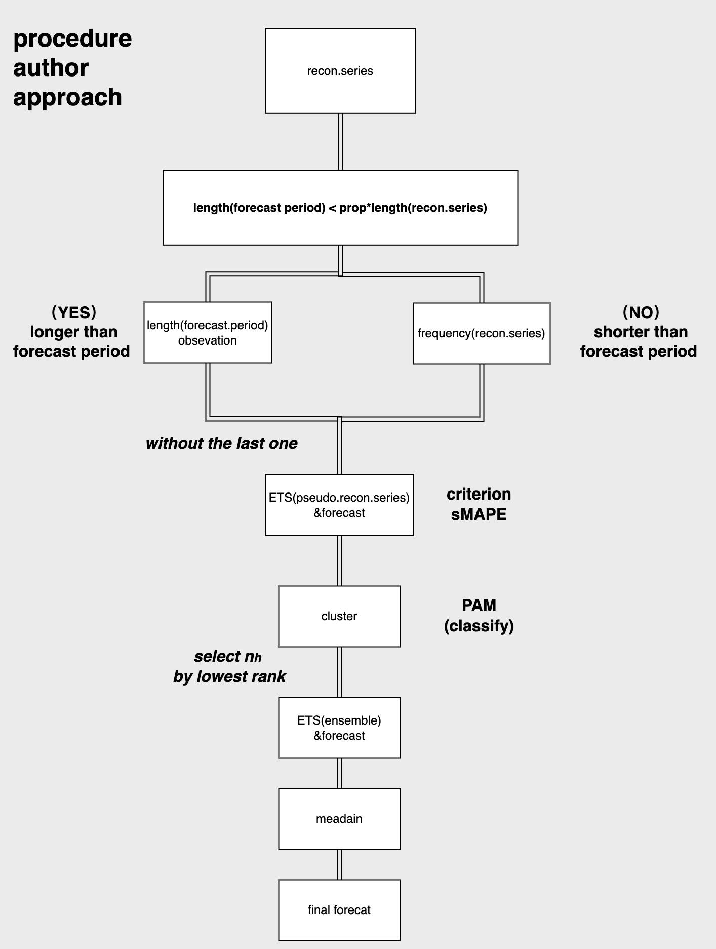
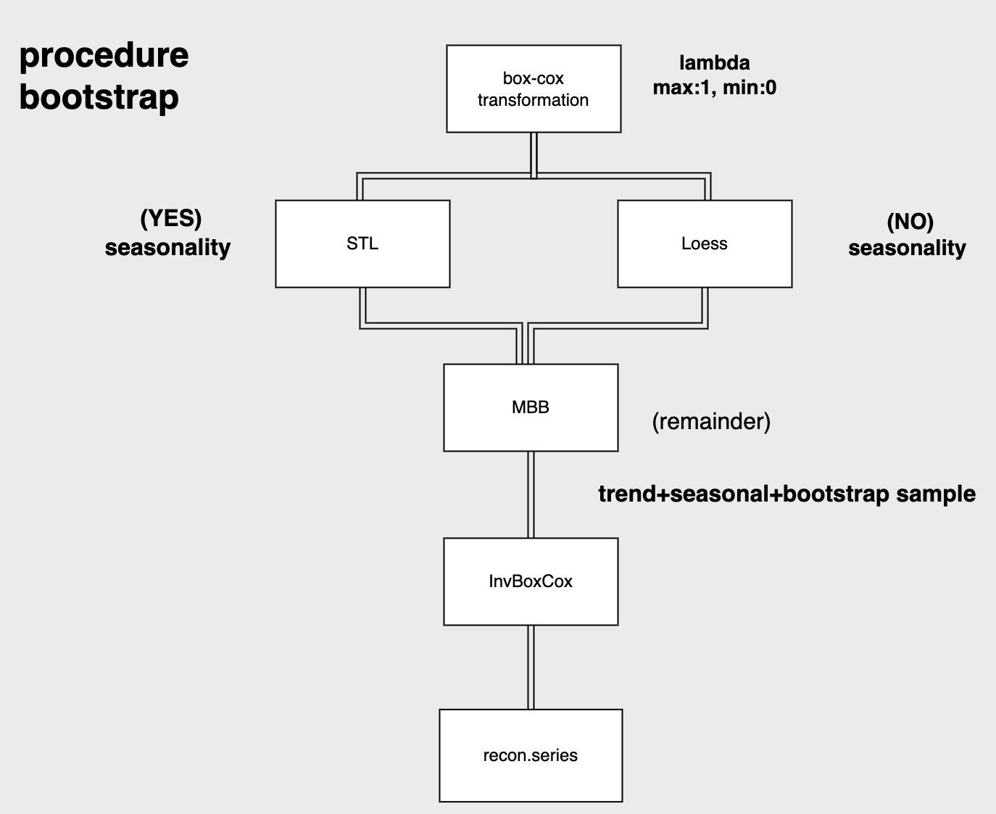
2. Method(Algorithm)
Bagged.Cluster.ETS

Slide 8
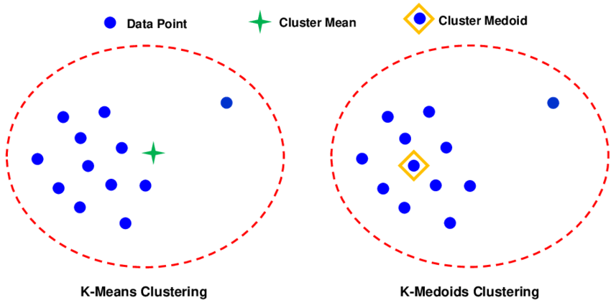
Cluster
1.How to classify each cluster?
PAM(Partitioning Around Medoids)
2.How to many series should pick up from cluster?
Selected n(h) from each cluster
this method proposal by the author
source:cluster

Slide 9
PAM(Partitioning Around Medoids)
Do k-mediods
（avoid outliers)
Unsupervised learning
(k-means/ k-mediods)
The PAM algorithm chooses k points/rows in the data to be medoids, or cluster centres.
The value k is a parameter that must be chosen (this can be chosen using Silhouette values, which are discussed later on in this post).
For each non-medoid point/row in the data, cluster membership is decided according to which medoid that point is closest to.
PAM consists of 2 phases: a BUILD phase and a SWAP phase.
In the BUILD phase, k initial medoid points are chosen.
In the SWAP phase, different medoid points are tried, until an optimal clustering is achieved.
I don’t describe or implement the BUILD phase (which is very simple) in this post, simply choosing random starting medoids. Further details can be found in the original paper:
choose k point/row to be medoids or cluster centres
value of k parameter
(following Silhouette values)
a measurement of the quality of a clustering
BUILD phase
SWAP phase
euclidean
distance
similarity&disimilarity
k initial medoid points are chosen
different medoid points are tried, until an optimal clustering is achieved
Notes:
The silhouette value always falls in the range [−1,1], where −1 is the least desirable value and 1 the most desirable.
The silhouette value can be used to identify well-performing clusters within a particular clustering, measure the overall quality of a particular clustering, and assist in choosing an optimal number of clusters to use (e.g. choice of k in k-means or PAM clustering). A large number of low or negative silhouette values is a sign of a bad clustering.

Slide 10
swap&build (detail in PAM)
SWAP
SWAP STEP
For each medoid point, do the following:
swap this medoid point with any non-medoid point
(i.e. the non-medoid point becomes a medoid point and the medoid point becomes a non-medoid point)
reassign every point to it’s closest medoid. Calculate the sum of distances of each point to it’s closest medoid.
Amongst all the swaps considered above, find the swap that resulted in the smallest sum of distances of each point to it’s closest medoid.
If the best swap gives a smaller sum of distances to closest medoid than we’ve seen before (i.e. the clustering improved), then do this swap.
Keep repeating this swap step until the clustering can not be improved (i.e. sum of distances of each point to it’s closest medoid can’t be reduced). This is the final clustering.
BUILD STEP
Choose k data points to be the starting medoids
(I have skipped this step and simply chosen random starting medoid points,
but this would not be difficult to code).
Each medoid point represents, in a sense, the centre of a cluster.
For each point, assign that point to it’s closest medoid point. This is how
clusters are decided. I measured distance using the ‘euclidean’ distance
measure, although another distance measure could have been used.
The sum of the distances of each point to it’s assigned medoid (i.e. tightness of clusters) measures the quality of a given clustering.

Slide 11
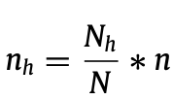
how to pick seires
Notation
n(h) : The number of time series selected from cluster
n : The number of series to be aggerated
N(h) : The total number of time series in cluster h
N : The total number of bootstrapped
h : No. cluster
note
N(h)： 落在每個cluster中的series 有幾條不一定
透過k-mediod分別
Ｎ：全部boostrapped series 文中使用數量為1000條
n:作者期望選出100條較佳的series
n(h):任意cluster中選出最小sMAPE seires

Slide 12
3. Bias and variance analysis
Four data generation processes
Autoregressive (AR)
Smooth Transition Autoregressive (STAR)
Exponential Smoothing state space model (ETS)
Seasonal Autoregressive Integrated Moving Average (SARIMA)
Comparison of the methodologies
Bagged.BLD.MBB.ETS
Bagged.BLD.MBB.Cluster.ETS(Proposed approach)
Notes:
Autoregressive: AR(6)
yt = 100 + 1.2401yt−1 − 0.419yt−2 − 0.1797yt−3+0.1267yt−4 −0.2259yt−5 +0.1697yt−6 +εt, (7)
where εt is independently and identically distributed (i.i.d.), N (0, 17.28).
Smooth transition autoregressive: STAR
y =500+0.3y +0.6y +(0.1−0.9yt t−1 t−1+ 0.8yt−2)[1 + e−10yt−1 ]−1 + εt ,
where εt is independently and identically distributed (i.i.d.), N (0, 1).
Exponential smoothing state space model: ETS(A,N,A)
yt =lt−1 +st−m +εt
lt = lt−1 + 0.5891εt
st = st−m + 0.001εt ,
where εt is independently and identically dis- tributed (i.i.d.), N (0, 264.75).
Seasonalautoregressiveintegratedmovingaverage: SARIMA(3, 0, 1)(0, 1, 2)12
yt = yt−12 + 0.1603(yt−1 − yt−13) −0.5481(yt−2 − yt−14) −0.5678(yt−3 − yt−15)
+ε − 0.5222ε t − 0.1768εt−24 +0.3827εt−1 − 0.1998459εt−13 −0.06766136εt −25 ,
where εt is independently and identically dis- tributed (i.i.d.), N (0, 0.06).

Slide 13
AR(6)
Measures | Bagged.BLD.MBB.ETS | Proposed approach
 |  | k = 5 | k = 10 | k = 20 | k = 40 | k = 80 | Automatic
Squared bias | 24.24961 | 23.95768 | 24.60746 | 25.50372 | 25.42617 | 24.08474 | 24.48792
Variance | 1878.05877 | 1796.92845 | 1805.87991 | 1800.33918 | 1812.08169 | 1869.32690 | 1836.71178
Squared bias and variance: STAR.
Measures | Bagged.BLD.MBB.ETS | Proposed approach
 |  | k = 5 | k = 10 | k = 20 | k = 40 | k = 80 | Automatic
Squared bias | 0.00188 | 0.00214 | 0.00215 | 0.00190 | 0.00194 | 0.00201 | 0.00198
Variance | 6.00350 | 5.55466 | 5.65972 | 5.58463 | 5.72152 | 5.79445 | 5.69631
Squared bias and variance: ETS.
Measures | Bagged.BLD.MBB.ETS | Proposed approach
 |  | k = 5 | k = 10 | k = 20 | k = 40 | k = 80 | Automatic
Squared bias | 172.29797 | 183.12050 | 183.40112 | 176.13825 | 181.46536 | 179.87989 | 173.58747
Variance | 41154.93728 | 39434.44026 | 39456.12883 | 39401.36690 | 39572.46175 | 40531.28877 | 40429.45484
Seasonal Autoregressive Integrated Moving Average (SARIMA)
Measures | Bagged.BLD.MBB.ETS | Proposed approach
 |  | k = 5 | k = 10 | k = 20 | k = 40 | k = 80 | Automatic
Squared bias | 3.66877E-05 | 3.49816E-05 | 3.51077E-05 | 3.57547E-05 | 3.4729E-05 | 3.58039E-05 | 3.5621E-05
Variance | 0.00387 | 0.00357 | 0.00358 | 0.00361 | 0.00361 | 0.00369 | 0.00368
AR(6)
Measures | Bagged.BLD.MBB.ETS | Proposed approach
 |  | k = 5 | k = 10 | k = 20 | k = 40 | k = 80 | Automatic
Squared bias | 24.24961 | 23.95768 | 24.60746 | 25.50372 | 25.42617 | 24.08474 | 24.48792
Variance | 1878.05877 | 1796.92845 | 1805.87991 | 1800.33918 | 1812.08169 | 1869.32690 | 1836.71178
Squared bias and variance: STAR.
Measures | Bagged.BLD.MBB.ETS | Proposed approach
 |  | k = 5 | k = 10 | k = 20 | k = 40 | k = 80 | Automatic
Squared bias | 0.00188 | 0.00214 | 0.00215 | 0.00190 | 0.00194 | 0.00201 | 0.00198
Variance | 6.00350 | 5.55466 | 5.65972 | 5.58463 | 5.72152 | 5.79445 | 5.69631
Squared bias and variance: ETS.
Measures | Bagged.BLD.MBB.ETS | Proposed approach
 |  | k = 5 | k = 10 | k = 20 | k = 40 | k = 80 | Automatic
Squared bias | 172.29797 | 183.12050 | 183.40112 | 176.13825 | 181.46536 | 179.87989 | 173.58747
Variance | 41154.93728 | 39434.44026 | 39456.12883 | 39401.36690 | 39572.46175 | 40531.28877 | 40429.45484
Seasonal Autoregressive Integrated Moving Average (SARIMA)
Measures | Bagged.BLD.MBB.ETS | Proposed approach
 |  | k = 5 | k = 10 | k = 20 | k = 40 | k = 80 | Automatic
Squared bias | 3.66877E-05 | 3.49816E-05 | 3.51077E-05 | 3.57547E-05 | 3.4729E-05 | 3.58039E-05 | 3.5621E-05
Variance | 0.00387 | 0.00357 | 0.00358 | 0.00361 | 0.00361 | 0.00369 | 0.00368
AR(6)
Measures | Bagged.BLD.MBB.ETS | Proposed approach
 |  | k = 5 | k = 10 | k = 20 | k = 40 | k = 80 | Automatic
Squared bias | 0% | 11%
Variance | 0% | -18%
Squared bias and variance: STAR.
Measures | Bagged.BLD.MBB.ETS | Proposed approach
 |  | k = 5 | k = 10 | k = 20 | k = 40 | k = 80 | Automatic
Squared bias | 0% | 45%
Variance | 0% | -33%
Squared bias and variance: ETS.
Measures | Bagged.BLD.MBB.ETS | Proposed approach
 |  | k = 5 | k = 10 | k = 20 | k = 40 | k = 80 | Automatic
Squared bias | 0% | 25%
Variance | 0% | -20%
Seasonal Autoregressive Integrated Moving Average (SARIMA)
Measures | Bagged.BLD.MBB.ETS | Proposed approach
 |  | k = 5 | k = 10 | k = 20 | k = 40 | k = 80 | Automatic
Squared bias | 0% | -22%
Variance | 0% | -38%
AR(6)
Measures | Bagged.BLD.MBB.ETS | Proposed approach
 |  | k = 5 | k = 10 | k = 20 | k = 40 | k = 80 | Automatic
Squared bias | 24.24961 | 23.95768 | 24.60746 | 25.50372 | 25.42617 | 24.08474 | 24.48792
Variance | 1878.05877 | 1796.92845 | 1805.87991 | 1800.33918 | 1812.08169 | 1869.32690 | 1836.71178
Squared bias and variance: STAR.
Measures | Bagged.BLD.MBB.ETS | Proposed approach
 |  | k = 5 | k = 10 | k = 20 | k = 40 | k = 80 | Automatic
Squared bias | 0.00188 | 0.00214 | 0.00215 | 0.00190 | 0.00194 | 0.00201 | 0.00198
Variance | 6.00350 | 5.55466 | 5.65972 | 5.58463 | 5.72152 | 5.79445 | 5.69631
Squared bias and variance: ETS.
Measures | Bagged.BLD.MBB.ETS | Proposed approach
 |  | k = 5 | k = 10 | k = 20 | k = 40 | k = 80 | Automatic
Squared bias | 172.29797 | 183.12050 | 183.40112 | 176.13825 | 181.46536 | 179.87989 | 173.58747
Variance | 41154.93728 | 39434.44026 | 39456.12883 | 39401.36690 | 39572.46175 | 40531.28877 | 40429.45484
Seasonal Autoregressive Integrated Moving Average (SARIMA)
Measures | Bagged.BLD.MBB.ETS | Proposed approach
 |  | k = 5 | k = 10 | k = 20 | k = 40 | k = 80 | Automatic
Squared bias | 3.66877E-05 | 3.49816E-05 | 3.51077E-05 | 3.57547E-05 | 3.4729E-05 | 3.58039E-05 | 3.5621E-05
Variance | 0.00387 | 0.00357 | 0.00358 | 0.00361 | 0.00361 | 0.00369 | 0.00368
AR(6)
Measures | Bagged.BLD.MBB.ETS | Proposed approach
 |  | k = 5 | k = 10 | k = 20 | k = 40 | k = 80 | Automatic
Squared bias | 24.24961 | 23.95768 | 24.60746 | 25.50372 | 25.42617 | 24.08474 | 24.48792
Variance | 1878.05877 | 1796.92845 | 1805.87991 | 1800.33918 | 1812.08169 | 1869.32690 | 1836.71178
Squared bias and variance: STAR.
Measures | Bagged.BLD.MBB.ETS | Proposed approach
 |  | k = 5 | k = 10 | k = 20 | k = 40 | k = 80 | Automatic
Squared bias | 0.00188 | 0.00214 | 0.00215 | 0.00190 | 0.00194 | 0.00201 | 0.00198
Variance | 6.00350 | 5.55466 | 5.65972 | 5.58463 | 5.72152 | 5.79445 | 5.69631
Squared bias and variance: ETS.
Measures | Bagged.BLD.MBB.ETS | Proposed approach
 |  | k = 5 | k = 10 | k = 20 | k = 40 | k = 80 | Automatic
Squared bias | 172.29797 | 183.12050 | 183.40112 | 176.13825 | 181.46536 | 179.87989 | 173.58747
Variance | 41154.93728 | 39434.44026 | 39456.12883 | 39401.36690 | 39572.46175 | 40531.28877 | 40429.45484
Seasonal Autoregressive Integrated Moving Average (SARIMA)
Measures | Bagged.BLD.MBB.ETS | Proposed approach
 |  | k = 5 | k = 10 | k = 20 | k = 40 | k = 80 | Automatic
Squared bias | 3.66877E-05 | 3.49816E-05 | 3.51077E-05 | 3.57547E-05 | 3.4729E-05 | 3.58039E-05 | 3.5621E-05
Variance | 0.00387 | 0.00357 | 0.00358 | 0.00361 | 0.00361 | 0.00369 | 0.00368
AR(6)
Measures | Bagged.BLD.MBB.ETS | Proposed approach
 |  | k = 5 | k = 10 | k = 20 | k = 40 | k = 80 | Automatic
Squared bias | 24.24961 | 23.95768 | 24.60746 | 25.50372 | 25.42617 | 24.08474 | 24.48792
Variance | 1878.05877 | 1796.92845 | 1805.87991 | 1800.33918 | 1812.08169 | 1869.32690 | 1836.71178
Squared bias and variance: STAR.
Measures | Bagged.BLD.MBB.ETS | Proposed approach
 |  | k = 5 | k = 10 | k = 20 | k = 40 | k = 80 | Automatic
Squared bias | 0.00188 | 0.00214 | 0.00215 | 0.00190 | 0.00194 | 0.00201 | 0.00198
Variance | 6.00350 | 5.55466 | 5.65972 | 5.58463 | 5.72152 | 5.79445 | 5.69631
Squared bias and variance: ETS.
Measures | Bagged.BLD.MBB.ETS | Proposed approach
 |  | k = 5 | k = 10 | k = 20 | k = 40 | k = 80 | Automatic
Squared bias | 172.29797 | 183.12050 | 183.40112 | 176.13825 | 181.46536 | 179.87989 | 173.58747
Variance | 41154.93728 | 39434.44026 | 39456.12883 | 39401.36690 | 39572.46175 | 40531.28877 | 40429.45484
Seasonal Autoregressive Integrated Moving Average (SARIMA)
Measures | Bagged.BLD.MBB.ETS | Proposed approach
 |  | k = 5 | k = 10 | k = 20 | k = 40 | k = 80 | Automatic
Squared bias | 3.66877E-05 | 3.49816E-05 | 3.51077E-05 | 3.57547E-05 | 3.4729E-05 | 3.58039E-05 | 3.5621E-05
Variance | 0.00387 | 0.00357 | 0.00358 | 0.00361 | 0.00361 | 0.00369 | 0.00368
AR(6)
Measures | Bagged.BLD.MBB.ETS | Proposed approach
 |  | k = 5 | k = 10 | k = 20 | k = 40 | k = 80 | Automatic
Squared bias | 0% | -1% | 1% | 5% | 5% | -1% | 1%
Variance | 0% | -4% | -4% | -4% | -4% | -0% | -2%
Squared bias and variance: STAR.
Measures | Bagged.BLD.MBB.ETS | Proposed approach
 |  | k = 5 | k = 10 | k = 20 | k = 40 | k = 80 | Automatic
Squared bias | 0% | 14% | 14% | 1% | 3% | 7% | 5%
Variance | 0% | -7% | -6% | -7% | -5% | -3% | -5%
Squared bias and variance: ETS.
Measures | Bagged.BLD.MBB.ETS | Proposed approach
 |  | k = 5 | k = 10 | k = 20 | k = 40 | k = 80 | Automatic
Squared bias | 0% | 6% | 6% | 2% | 5% | 4% | 1%
Variance | 0% | -4% | -4% | -4% | -4% | -2% | -2%
Seasonal Autoregressive Integrated Moving Average (SARIMA)
Measures | Bagged.BLD.MBB.ETS | Proposed approach
 |  | k = 5 | k = 10 | k = 20 | k = 40 | k = 80 | Automatic
Squared bias | 0% | -5% | -4% | -3% | -5% | -2% | -3%
Variance | 0% | -8% | -7% | -7% | -7% | -5% | -5%
Notes:
Autoregressive: AR(6)
yt = 100 + 1.2401yt−1 − 0.419yt−2 − 0.1797yt−3+0.1267yt−4 −0.2259yt−5 +0.1697yt−6 +εt, (7)
where εt is independently and identically distributed (i.i.d.), N (0, 17.28).
Smooth transition autoregressive: STAR
y =500+0.3y +0.6y +(0.1−0.9yt t−1 t−1+ 0.8yt−2)[1 + e−10yt−1 ]−1 + εt ,
where εt is independently and identically distributed (i.i.d.), N (0, 1).
Exponential smoothing state space model: ETS(A,N,A)
yt =lt−1 +st−m +εt
lt = lt−1 + 0.5891εt
st = st−m + 0.001εt ,
where εt is independently and identically dis- tributed (i.i.d.), N (0, 264.75).
Seasonalautoregressiveintegratedmovingaverage: SARIMA(3, 0, 1)(0, 1, 2)12
yt = yt−12 + 0.1603(yt−1 − yt−13) −0.5481(yt−2 − yt−14) −0.5678(yt−3 − yt−15)
+ε − 0.5222ε t − 0.1768εt−24 +0.3827εt−1 − 0.1998459εt−13 −0.06766136εt −25 ,
where εt is independently and identically dis- tributed (i.i.d.), N (0, 0.06).

Slide 14
4. Forecasting competition data
M3
With 1428 monthly, 756 quarterly and 645 yearly time series.
6 different types of series: Micro, Industry, Finance, Demographic and Other
CIF 2016
With 72 monthly time series, (24 are real time series and 48 are generated artificially)
Type of series: Bank
Notes:
M3
The time horizons of forecasting are:
6 periods for yearly data,
8 periods for quarterly data,
18 periods for monthly data,
8 periods for other data.
CIF2016
There are two forecast horizons considered in the competition where
57 series consider the forecast horizon as 12
15 series consider the forecast horizon as 6

Slide 15
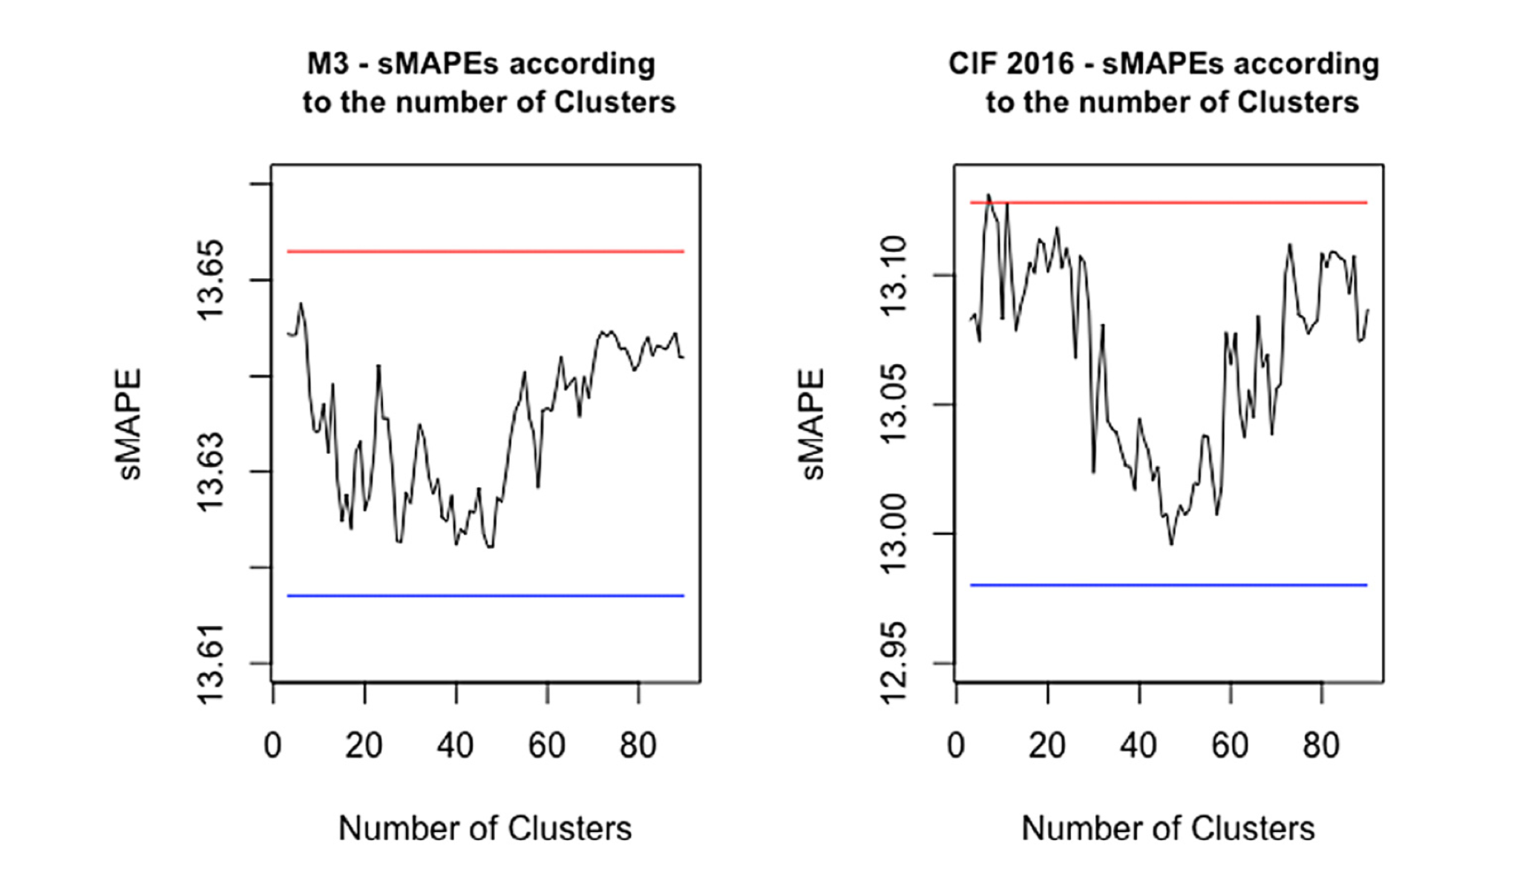
Effects on the number of clusters
Notes:
Therefore, it is not surprising that having an equilibrium between the number of clusters and the number of time series (in this case, the number of clusters is between 40% and 50% of the number of series) leads to smaller forecast errors.
1000條資料，丟進n個clusters後，再篩選出100條，再取中位數。

Slide 16
M3 competition data
M3 monthly data
 |  | Comparison(methodologies) | Friedman rank-sum test
Methods | Rank | Rank sMAPE | Adjusted p-value
Proposed approach | 1 | 11.553
Bagged.BLD.MBB.ETS | 2 | 11.709 | 0.599
THETA | 3 | 11.983 | 0.147
ForecastPro | 4 | 12.000 | 0.132
COMB S-H-D | 5 | 13.028 | 6.791E-07
ETS | 6 | 13.056 | 4.159E-07
ForcX | 7 | 13.260 | 8.991E-09
HOLT | 8 | 13.288 | 5.125E-09
WINTER | 9 | 13.582 | 8.304E-12
RBF | 10 | 13.808 | 3.114E-14
DAMPEN | 11 | 14.006 | 1.449E-16
AAM1 | 12 | 14.009 | 1.325E-16
AutoBox2 | 13 | 14.151 | 2.205E-18
B-J auto | 14 | 14.220 | 2.744E-19
M3 quarterly data.
 |  | Comparison(methodologies) | Friedman rank-sum test
Methods | Rank | Rank sMAPE | Adjusted p-value
THETA | 1 | 11.817
COMB S-H-D | 2 | 12.620 | 0.049
ROBUST-Trend | 3 | 12.915 | 0.007
DAMPEN | 4 | 13.109 | 0.002
PP-Autocast | 5 | 13.272 | 3.674E-4
ForcX | 6 | 13.349 | 1.754E-4
Bagged.BLD.MBB.ETS | 7 | 13.464 | 5.486E-5
B-J auto | 8 | 13.655 | 6.729E-6
ETS | 9 | 13.717 | 3.276E-6
ForecastPro | 10 | 13.729 | 2.842E-6
Proposed approach | 11 | 13.742 | 2.425E-6
HOLT | 12 | 13.771 | 1.719E-6
RBF | 13 | 13.796 | 1.252E-6
AutoBox2 | 14 | 13.871 | 4.900E-7
M3 yearly data.
 |  | Comparison(methodologies) | Friedman rank-sum test
 | Rank | Rank sMAPE | Adjusted p-value
ForcX | 1 | 11.596
RBF | 2 | 11.929 | 0.417
AutoBox2 | 3 | 11.953 | 0.384
Flors-Pearc1 | 4 | 12.044 | 0.274
THETA | 5 | 12.068 | 0.249
ForecastPro | 6 | 12.238 | 0.117
ROBUST-Trend | 7 | 12.302 | 0.085
PP-Autocast | 8 | 12.366 | 0.060
Bagged.BLD.MBB.ETS | 9 | 12.402 | 0.049
DAMPEN | 10 | 12.426 | 0.043
COMB S-H-D | 11 | 12.499 | 0.027
ETS | 12 | 12.535 | 0.022
Proposed approach | 13 | 12.727 | 0.006
SMARTFCS | 14 | 12.901 | 0.001
Proposed method had a smaller variance than those from Bagged.BLD.MBB.ETS.
h |  | Monthly |  | Quaterly | Yearly
1 | 10 | 50.98% | 53.99% | 49.47% | 45.43%
2 | 11 | 53.15% | 53.01% | 50.40% | 48.06%
3 | 12 | 53.15% | 51.54% | 49.47% | 47.60%
4 | 13 | 53.99% | 52.59% | 47.22% | 47.75%
5 | 14 | 53.78% | 52.94% | 46.96% | 48.68%
6 | 15 | 55.25% | 53.99% | 48.81% | 48.53%
7 | 16 | 56.93% | 53.29% | 48.54%
8 | 17 | 58.26% | 53.99% | 48.15%
9 | 18 | 55.39% | 54.97%

Slide 17
CIF2016 competition data
CIF2016
Artificial series. |  | Real series. |  | All series.
Methods | Rank sMAPE | Methods | Rank sMAPE | Methods | Rank sMAPE
Proposed approach | 6.896 | Ensemble of LSTMs and ETS | 8.292 | Ensemble of LSTMs an ETS | 8.500
Bagged.BLD.MBB.ETS | 7.146 | LSTM deseasonalized | 9.125 | Proposed approach | 8.597
Ensemble of LSTMs and ETS | 8.604 | MLP | 10.583 | Bagged.BLD.MBB.ETS | 9.181
ETS | 8.771 | Fuzzy c-regression m | 10.750 | LSTM deseasonalized | 9.250
FRBE | 9.208 | REST | 10.917 | ETS | 9.792
LSTM deseasonalized | 9.312 | TSFIS | 11.062 | MLP | 10.181
Boot.EXPOS | 9.729 | AVG | 11.458 | FRBE | 10.222
MLP | 9.979 | Random walk | 11.792 | HEM | 11.333
ARIMA | 10.958 | ETS | 11.833 | REST | 11.431
HEM | 10.979 | Proposed approach | 12.000 | Boot.EXPOS | 11.528
REST | 11.688 | HEM | 12.042 | ARIMA | 11.896
PB-GRNN | 11.917 | FRBE | 12.250 | AVG | 12.514
PB-RF | 11.917 | LSTM | 12.958 | PB-GRNN | 12.569
PB-MLP | 12.229 | THETA | 13.125 | PB-RE | 12.569
AVG | 13.042 | Bagged.BLD.MBB.ETS | 13.250 | PB-MLP | 12.972
CIF2016
Artificial series. |  | Real series. |  | All series.
Methods | Rank sMAPE | Methods | Rank sMAPE | Methods | Rank sMAPE
Proposed approach | 6.896 | Ensemble of LSTMs and ETS | 8.292 | Ensemble of LSTMs an ETS | 8.500
Bagged.BLD.MBB.ETS | 7.146 | LSTM deseasonalized | 9.125 | Proposed approach | 8.597
Ensemble of LSTMs and ETS | 8.604 | MLP | 10.583 | Bagged.BLD.MBB.ETS | 9.181
ETS | 8.771 | Fuzzy c-regression m | 10.750 | LSTM deseasonalized | 9.250
FRBE | 9.208 | REST | 10.917 | ETS | 9.792
LSTM deseasonalized | 9.312 | TSFIS | 11.062 | MLP | 10.181
Boot.EXPOS | 9.729 | AVG | 11.458 | FRBE | 10.222
MLP | 9.979 | Random walk | 11.792 | HEM | 11.333
ARIMA | 10.958 | ETS | 11.833 | REST | 11.431
HEM | 10.979 | Proposed approach | 12.000 | Boot.EXPOS | 11.528
REST | 11.688 | HEM | 12.042 | ARIMA | 11.896
PB-GRNN | 11.917 | FRBE | 12.250 | AVG | 12.514
PB-RF | 11.917 | LSTM | 12.958 | PB-GRNN | 12.569
PB-MLP | 12.229 | THETA | 13.125 | PB-RE | 12.569
AVG | 13.042 | Bagged.BLD.MBB.ETS | 13.250 | PB-MLP | 12.972
CIF2016
Artificial series. |  | Real series. |  | All series.
Methods | Rank sMAPE | Methods | Rank sMAPE | Methods | Rank sMAPE
Proposed approach | 6.896 | Ensemble of LSTMs and ETS | 8.292 | Ensemble of LSTMs an ETS | 8.500
Bagged.BLD.MBB.ETS | 7.146 | LSTM deseasonalized | 9.125 | Proposed approach | 8.597
Ensemble of LSTMs and ETS | 8.604 | MLP | 10.583 | Bagged.BLD.MBB.ETS | 9.181
ETS | 8.771 | Fuzzy c-regression m | 10.750 | LSTM deseasonalized | 9.250
FRBE | 9.208 | REST | 10.917 | ETS | 9.792
LSTM deseasonalized | 9.312 | TSFIS | 11.062 | MLP | 10.181
Boot.EXPOS | 9.729 | AVG | 11.458 | FRBE | 10.222
MLP | 9.979 | Random walk | 11.792 | HEM | 11.333
ARIMA | 10.958 | ETS | 11.833 | REST | 11.431
HEM | 10.979 | Proposed approach | 12.000 | Boot.EXPOS | 11.528
REST | 11.688 | HEM | 12.042 | ARIMA | 11.896
PB-GRNN | 11.917 | FRBE | 12.250 | AVG | 12.514
PB-RF | 11.917 | LSTM | 12.958 | PB-GRNN | 12.569
PB-MLP | 12.229 | THETA | 13.125 | PB-RE | 12.569
AVG | 13.042 | Bagged.BLD.MBB.ETS | 13.250 | PB-MLP | 12.972
Notes:
24 are real time series and 48 are generated artificially
The increase in the variance for the quarterly and yearly cases helps to explain the poor forecasting performances.
One point that needs to be highlighted is that the quarterly and yearly time series are significantly shorter than the monthly series;
that is,
while the median length for the monthly time series is 115,
those for the quarterly and yearly cases are 44 and 19, respectively.

Slide 18
5. Conclusion
To reduce the covariance effect through the use of clusters is the reason for the improvement in the results.
The advantage of cluster method can become a drawback if the time series is too short.
Notes:
如果時間序列太短，因為clusters的算法可能會受到序列長度的影響。
The increase in the variance for the quarterly and yearly cases helps to explain the poor forecasting performances. One point that needs to be highlighted is that the quarterly and yearly time series are significantly shorter than the monthly series; that is, while the median length for the monthly time series is 115, those for the quarterly and yearly cases are 44 and 19, respectively.

Slide 19
References＆Recommending Papers
Finding groups in data : An introduction to cluster analysis.JohnWiley&Sons
Kaufman,L.,Rousseeuw,P.J. (2009)
Clustering of time series data—a survey
T. Warren Liao (2005)
Bagging Exponential Smoothing Methods using STL Decomposition and Box-Cox Transformation
Christoph Bergmeira, Rob J Hyndman (2016)
The M3-Competition: results, conclusions and implications
Spyros Makridakis, Miche`le Hibon (2000)
Judgmental selection of forecasting models
Fotios Petropoulosa, Nikolaos Kourentzesb, Konstantinos Nikolopoulosc, Enno Siemsen (2018)
Getting the most out of the wisdom of the crowds: improving forecasting performance through ensemble methods and variable selection techniques
Erick Meira de Oliveira (2020)
文章＆網站連結

